Slide 1

Processor Extensions to Support Dual-Core Code Synchronization
Project Number: 3030
Students: Ido Shalev, Matan Levin
Supervisor: Oren Ganon
Location: Tel Aviv University, Projects Lab

Slide 2
What is the Project ?
p0
We extended the DLX processor into a dual- core system with shared memory, adding atomic instructions and synchronization hardware to guarantee safe parallel execution
EXTENSION
PC MASTER
SyncBox
p1
EXTENSION
Our custom Hardware RTL design

Slide 3
Goals
Motivation: Multi-core improves speed & efficiency, but DLX lacks atomic ops → unsafe external memory access, might cause logical and technical failures.
Solution: We Extended the DLX with atomic instructions (LR/SC, SWAP, AMOADD).
Design: Added SyncBox hardware for safe memory access synchronization and we extended each core’s control unit with 4 new states while keeping original DLX functionality.
Impact: Enables secure dual-core execution, supports parallel workloads and improves efficiency.

Slide 4
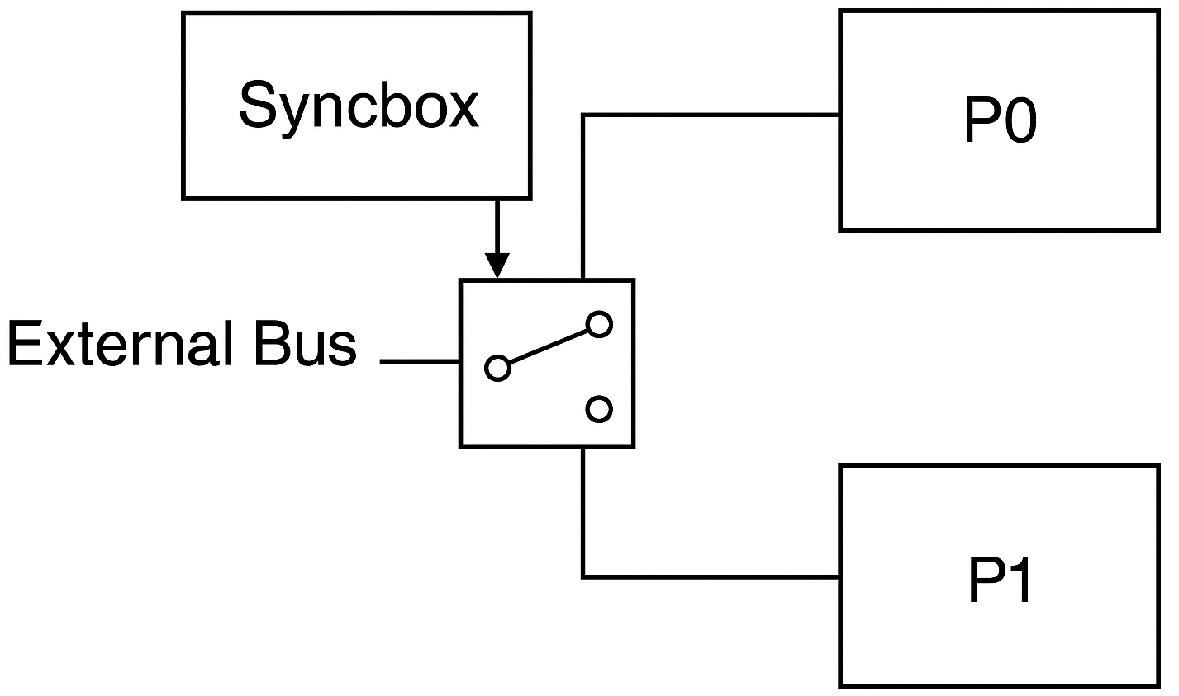
Challenges in Single-Core DLX for Dual-Core
Even with atomicity support both cores can’t access external memory at the same time and have to take turns thus reducing parallelism for memory access instructions.

Slide 5
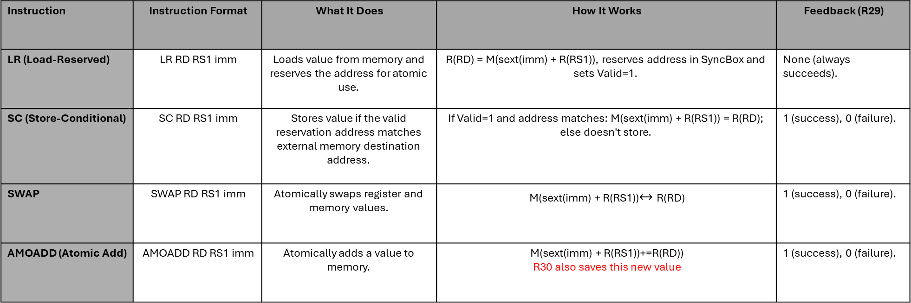
Atomic Instructions
Atomic operations are indivisible instructions that execute completely or not at all, ensuring that no other process can interrupt or interfere with them midway. In multi-core systems like ours, they prevent race conditions by guaranteeing exclusive access to shared memory during read-write sequences, maintaining data consistency and secure memory accessing .
The instructions we implemented are:
Feedback (R29) | How It Works | What It Does | Instruction Format | Instruction
None (always succeeds). | R(RD) = M(sext(imm) + R(RS1)), reserves address in SyncBox and sets Valid=1. | Loads value from memory and reserves the address for atomic use. | LR RD RS1 imm | LR (Load-Reserved)
1 (success), 0 (failure). | If Valid=1 and address matches: M(sext(imm) + R(RS1)) = R(RD); else doesn't store. | Stores value if the valid reservation address matches external memory destination address. | SC RD RS1 imm | SC (Store-Conditional)
1 (success), 0 (failure). | M(sext(imm) + R(RS1))$↔$ R(RD) | Atomically swaps register and memory values. | SWAP RD RS1 imm | SWAP
1 (success), 0 (failure). | M(sext(imm) + R(RS1))+=R(RD)) R30 also saves this new value | Atomically adds a value to memory. | AMOADD RD RS1 imm | AMOADD (Atomic Add)

Slide 6
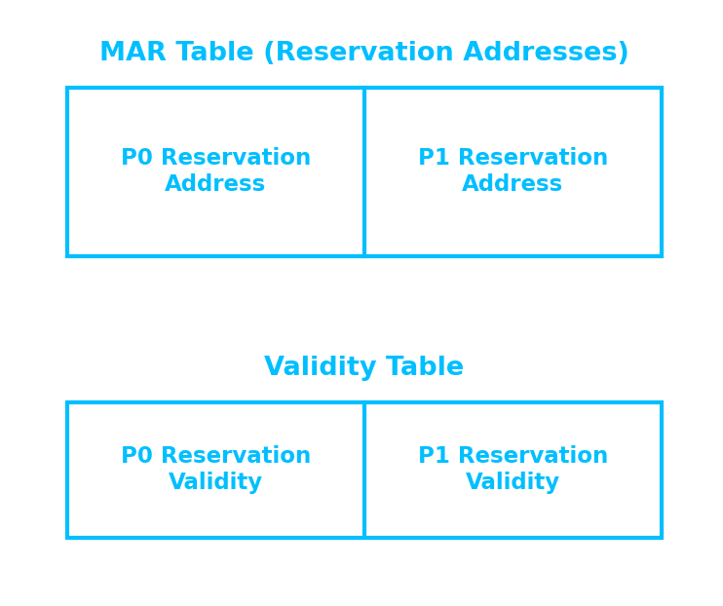
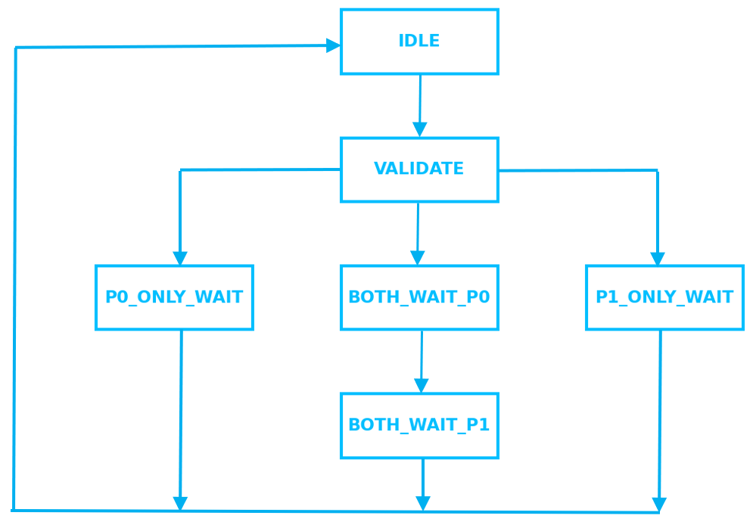
Implementation-SyncBox Design
Syncbox’s data-path
A hardware unit that manages access to the external memory between P0 and P1 (using a mux and its output signals).
Data path containing MAR table (reservation addresses table) and Validity table (tell which reservations are valid)
Utilizes a finite control state machine, which helps to coordinate how the two DLX cores access the shared memory.
FSM States Roles
IDLE – No requests pending; system is waiting.
VALIDATE – Check requests and decide which core(s) will run.
P0_ONLY_WAIT – Core 0 is using memory; FSM waits until it’s done.
P1_ONLY_WAIT – Core 1 is using memory; FSM waits until it’s done.
BOTH_WAIT_P0 – Both asked at once → serve Core 0 first.
BOTH_WAIT_P1 – Then serve Core 1, and return to IDLE.
Syncbox’s control state machine

Slide 7
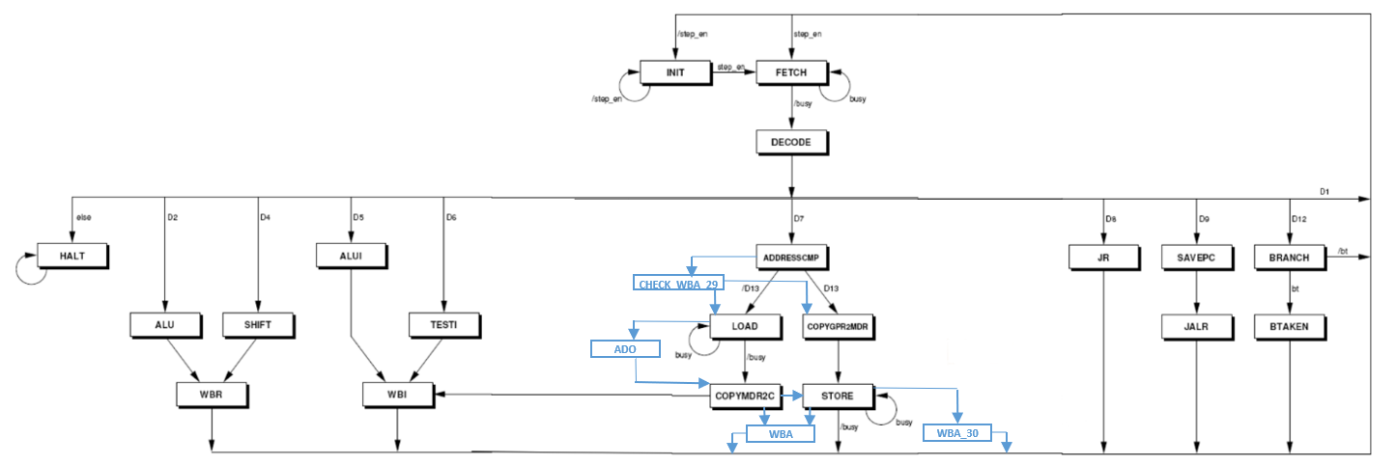
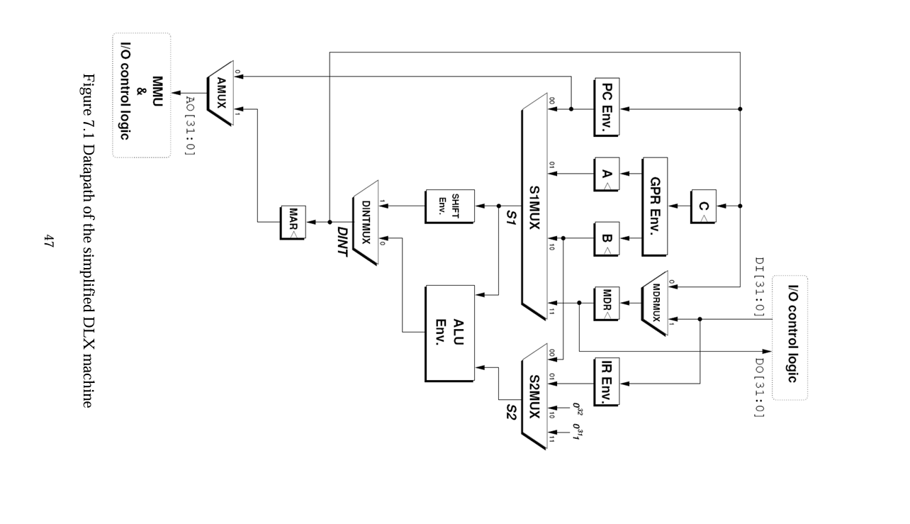

Implementation=Cores’ Control State Machine
The DLX Control Unit Finite State Machine (FSM) manages instruction execution in each core, Original states are those of the simplified DLX.
4 new states are added to support atomic instructions, both supporting new data operations and helping synchronization via SyncBox.
Added States:
CHECK_WBA_29: waiting instruction success/failure feedback from SyncBox. help sets what value 1 (success) or 0 (failure) will be written to R29 based on Syncbox’s arbitration.
ADO: Performs the addition of the AMOADD after both the register value and external memory value are accessible for him in order to compute their sum.
WBA: Write-Back Address phase, writes value loaded from external memory (in SWAP and SC) to an internal RAM register.
WBA_30: Write-Back phase for AMOADD, updates R30 with the new sum (which was also saved in the external memory).

Slide 8
Tools and Environment
Project Start
Verilog for hardware description (Datapath, Control Unit, SyncBox(.
ModelSim for RTL simulation and debugging.
Xilinx ISE for synthesis and Netlist generation(Verilog to logic gates mapping).
RESA-2 for assembly code testing and FPGA emulation on Xilinx Spartan-6.
(Flowchart of implementation steps: Design → Simulation → Synthesis → Testing)
Write Verilog Code (Datapath, Control Unit, SyncBox)
Simulate with ModelSim
Synthesize with Xilinx
Emulate with RESA-2
Final Validation

Slide 9
Simulation Environment
We used ModelSim’s waveforms for functional validation of the cores’ signals, and register tables for internal Rams and external memory simulation for clear and simple check.
Helped ensure correctness before hardware deployment.
We verified all edge cases work — important selected few are:
Scenario | What We Verified
Both cores perform LR on the same address | Each core got its own reservation; stayed valid until SC or a write.
SC after valid LR (success case) | SC succeeded when the reservation was still valid and correctly updated memory.
Both cores perform SC / AMOADD / SWAP to the same address (same cycle) | Both cores issued valid SC, AMOADD, or SWAP to the same address in the same cycle — P0 succeeds, P1’s operation fails with no corruption.
SC / AMOADD / SWAP to the reserved address | Clears reservations for any core by any core — any write to the reserved address cancels all reservations to it.
SC / AMOADD / SWAP to a different address | Verified that when any of the three targeted a different address than the reserved one, the original reservation stayed valid.

Slide 10







Test scenario: Parallel LR/SC on the Same Memory Address
P0 code snippet:
P1 code snippet:
The external memory’s initial value at address 6 is 3:
After executing first 2 instructions (lr, addi) P0’s R1 value and P1’s R1 value are 4 and 5 respectively:
P0‘s RAM(R1) :
P0‘s RAM(R1) :
Reservations table (MAR table):
validity table :
Both cores made valid reservations at address 6
After executing Sc instruction in both cores:
Only P0’s SC instruction succeeded!
Validity table is nullified in any case of attempted write to external memory
External memory:
validity table :
P0‘s RAM(R29) :
P1‘s RAM(R29) :

Slide 11
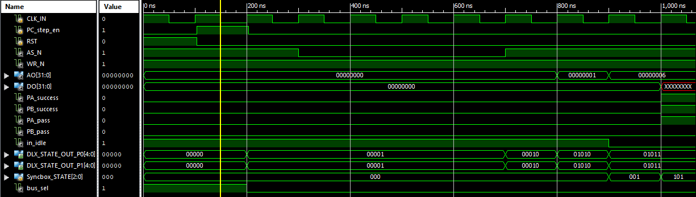
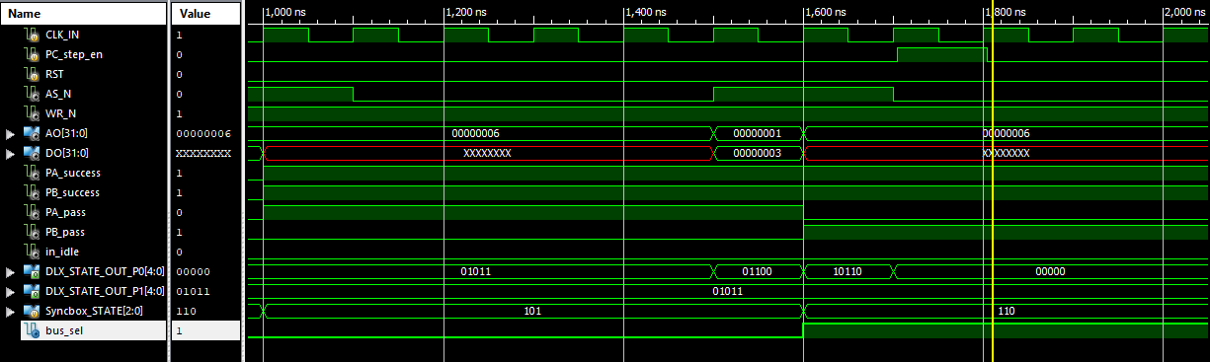
Dual accesses to same address’s Waveform Simulation - LR
First both cores’ states transition as follows:
INIT → FETCH → DECODE → ADDRESSCMP → LOAD(01011).
SyncBox grants P0 bus access first (PA_pass is ‘1’, bus_sel = ‘0’), P1 waits in LOAD (01011).
At 1600 ns P1 finished loading from external memory so bus_sel in now ‘1’ (selecting P1) ,PB_pass is now ‘1’ signaling to P1 the bus in now his.

Slide 12
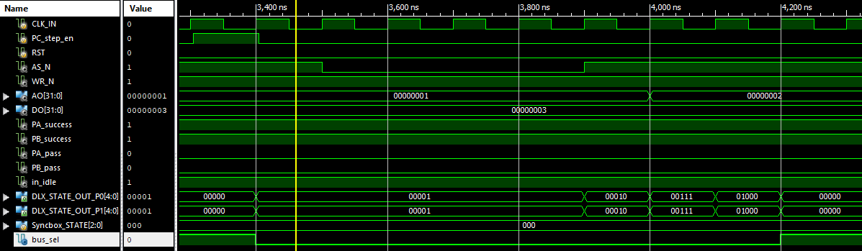
Dual accesses to same address’s Waveform Simulation - ADDI
Symmetric execution (INIT → FETCH → DECODE → ALUI → WBI → INIT), internal instruction for each core thus no external memory access arbitration is needed.

Slide 13
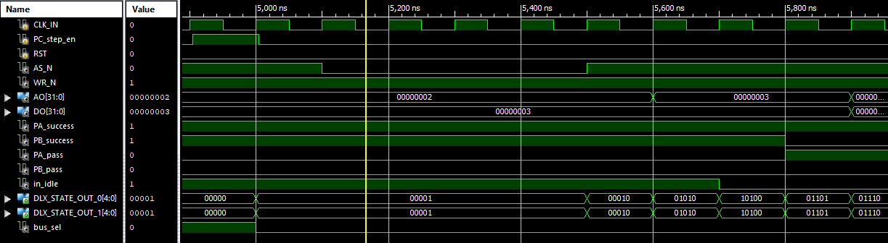
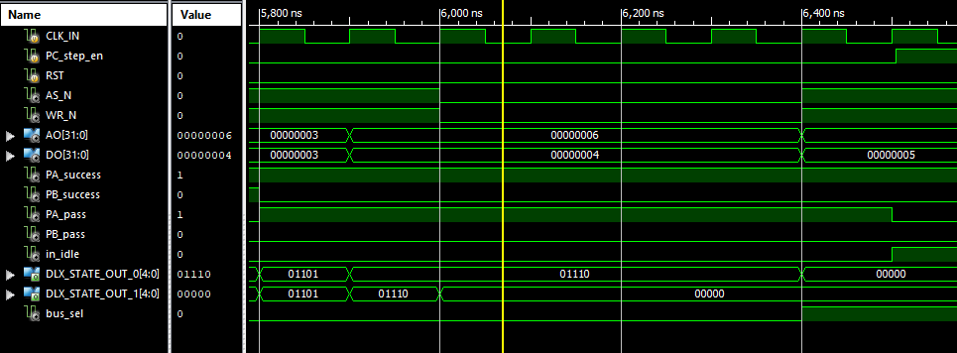
Dual accesses to same address’s Waveform Simulation - SC
At first both cores reach the state STORE(01110) simultaneously .
The SyncBox grants P0 access to memory (PA_pass is high, bus_sel = 0) while preventing P1 from accessing the memory by turning PB_success low ,indicating failure (P0 is granted precedence over P1)
Thus P1 transitions to INIT state (00000) immediately and P0 remain in STORE(01110) until he finishes writing to external memory and than he also reverts to INIT (00000) state.

Slide 14

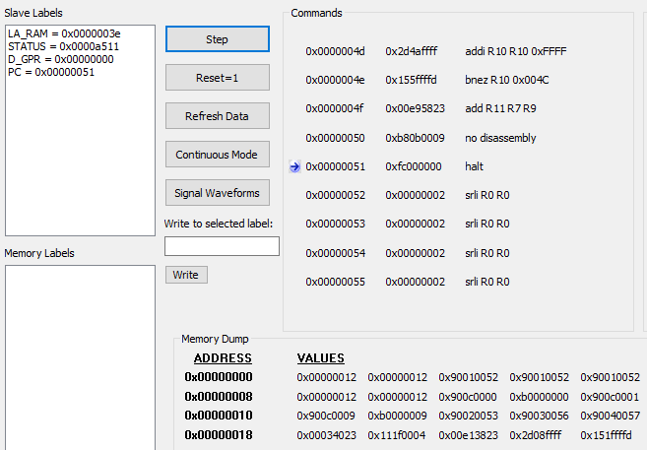

Emualtion
Wrote full matrix-multiplication assembly code with atomic instructions
Deployed the design to the RESA FPGA board
Verified that hardware results matched the IO sim simulation results
One of many matrix multiplication code example we compared is:
RESA:
IO SIM:
The results are indeed identical

Slide 15



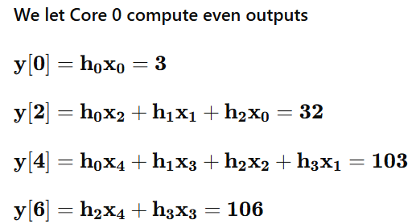
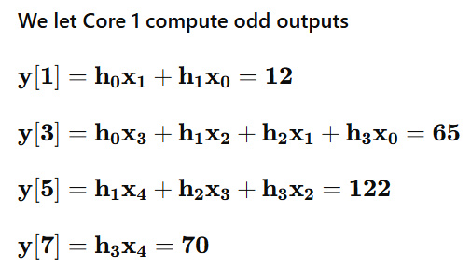
Case usage example- Convolution and matrixes multiplication
Convolution and matrix multiplication are ideal for dual-core execution, yielding near-2× speedup.
Most of the work is internal parallel computations (multiplications), the few shared-bus memory accesses are minor.
An illustrative convolution example we ran is:
The results are:
Simplified DLX runtime: 7838 clock cycles
Dual core runtime: 4242 clock cycles
Already for small input values we got relatively close to 2x speedup of 1.85x!

Slide 16

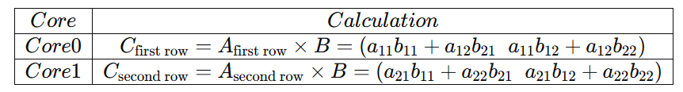
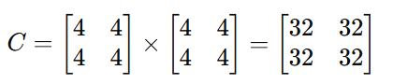
Case usage example- Convolution and matrixes multiplication
In our code we split the workload between the cores in the following manner:
Why this split is balanced
In assembly, multiplication (x*y) is a series of y additions of x. Each element of B tells how many times the matching element of A is added. By the table we see that for each calculated row, the total additions is the sum of all elements in B which is exactly balanced between both cores.
The example we simulated is:
The runtimes we got were 6783 cycles for the simplified DLX and 3572 cycles for the dual core DLX, achieving a speedup of 1.9×.

Slide 17
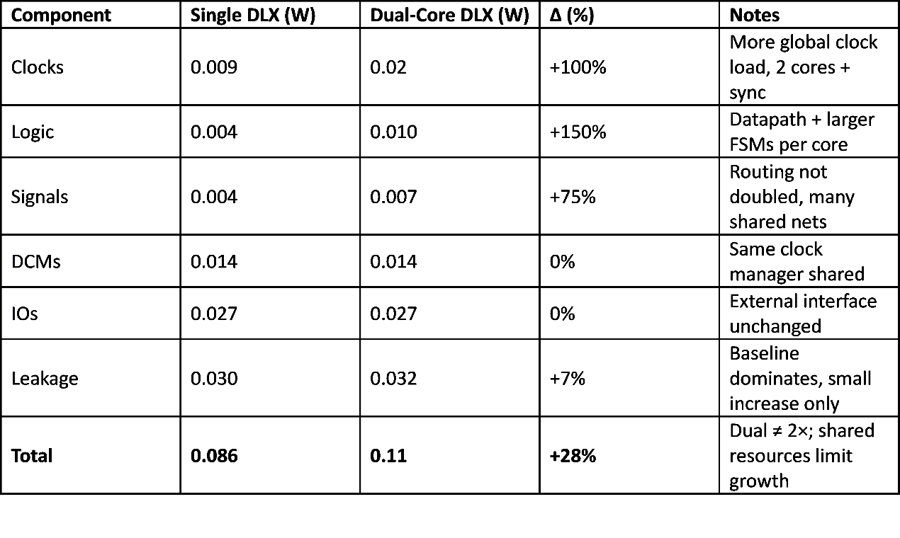
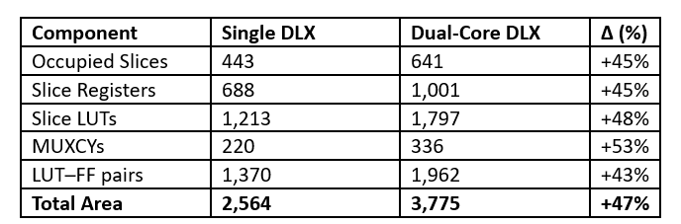
Results- Area and Power
Power Consumption:
Single-core: 0.086 W → Dual-core: 0.11 W (+28%)
Breakdown: Clock +100%, Logic +150%, Signals +75%, Leakage +7%. DCMs/IOs unchanged
Conclusion: Restrained power due to shared clocking/IO and the FPGA’s static floor keep it way below 2× scaling.
Area Utilization:
Single-core: 2,564 units → Dual-core: 3,775 units (+47%), across key metrics (Registers, LUTs, Slices, MUXCYs).
Clock managers, IO buffers, and much of the interconnect fabric are reused rather than duplicated.
Efficient packing (co-located LUTs/registers from different cores into the same slice)
Conclusion: Area overhead is contained and aligns with expectations for a dual-core upgrade with richer control, remaining comfortably within device capacity (xc6slx25).

Slide 18
Conclusions
Achievements:
Successful dual-core DLX with atomic support (LR/SC, SWAP, AMOADD) on FPGA.
Dual core parallelism ensured synchronization with minimal hardware (area +47%, power +26%) far below a naive 2x scaling.
Meets goals: No race conditions, preserved DLX compatibility, validated in simulation/emulation.
Performance: shown 1.85–1.90× speedup in parallel workloads (convolution and matrix multiplication), confirming feasibility for shared-memory parallelism.
conclusion:
The dual-core processor is especially effective for workloads where most of the computation is carried out internally within each core simultaneously (in a balanced way) , rather than through frequent reads and writes to external memory.
Adding another core, with minimal synchronization hardware, can already provide substantial performance gains without excessive area or power costs due to reused wiring and FPGA resources.

Slide 19
Further Work
Shared Data Reads: Broadcast single read to both cores if same data needed (saves cycles).
Sharing Computed Results: Allow one core's result to be shared, avoiding recalculation.
Smarter Stalling: Permit internal work during memory arbitration (overlap arithmetic/memory delays).
Dual-Core Aware Assembler: Auto-balance workloads between cores (e.g., even/odd outputs)
Shallow Pipelining: Introduce fetch/decode/execute/write-back stages with forwarding/stalls for higher throughput.

Slide 20

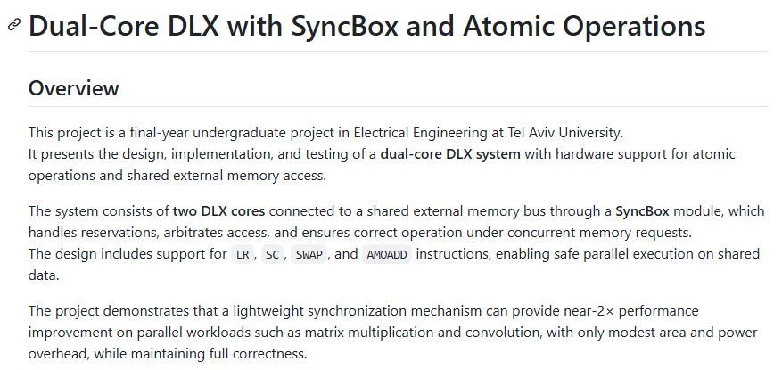
Documentation
https://github.com/Idoshalev7/Dual_Core_Project/tree/main

